Slide 1
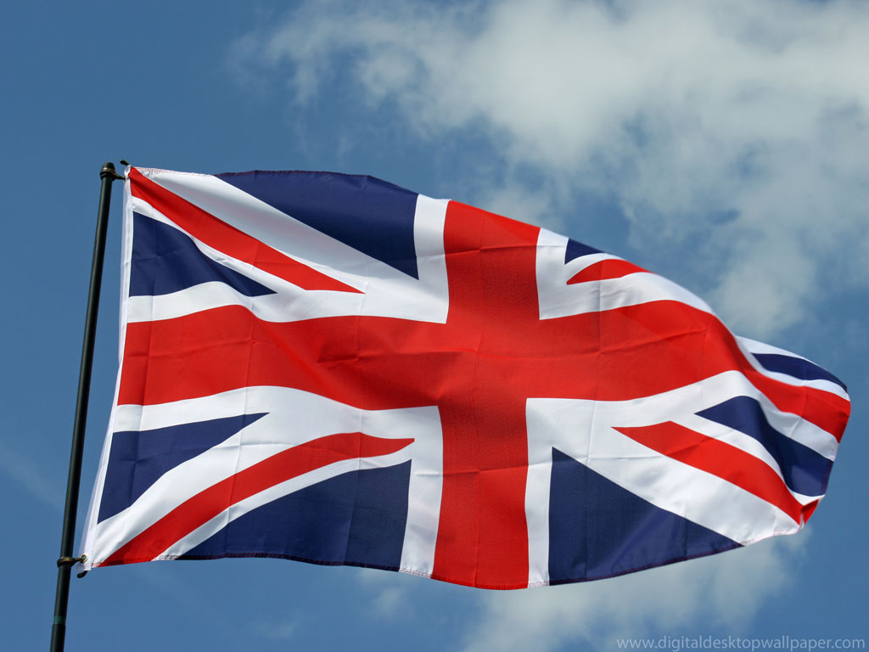
GREAT BRITAIN QUIZ

Slide 2
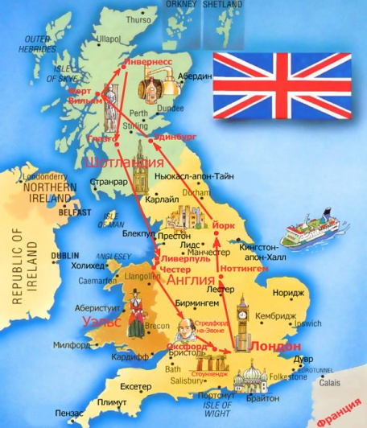
ROUND 1
COUNTRIES, CAPITALS, FLAGS

Slide 3
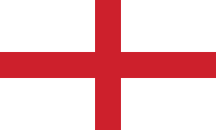
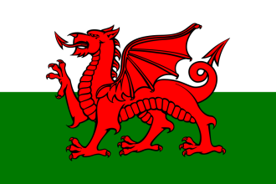


Match the names of the countries with their capitals and flags
1
2
3
4
England
Scotland
Wales
Northern Ireland
Edinburg
Belfast
Cardiff
London

Slide 4
Match the names of the countries with their capitals and flags
1
2
3
4
England
Wales
Scotland
Northern
Ireland
London
Edinburg
Cardiff
Belfast

Slide 5

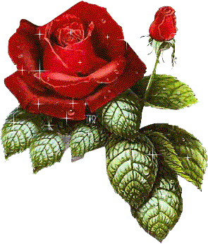
ROUND 2
Symbols

Slide 6
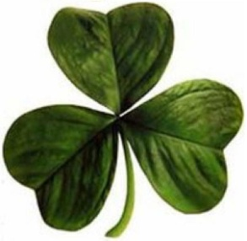
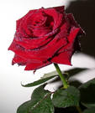
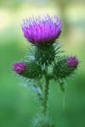

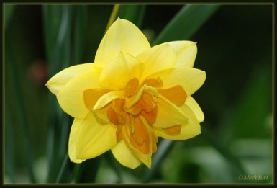
Match the countries to their
national symbols
England
Scotland
Northern Ireland
Wales

Slide 7
Match the countries to their
national symbols
Northern Ireland
England
Wales
Scotland

Slide 8

ROUND 3
What? Where? When?

Slide 9
1. Who is the national hero of Britain, the defender of the poor?

Slide 10
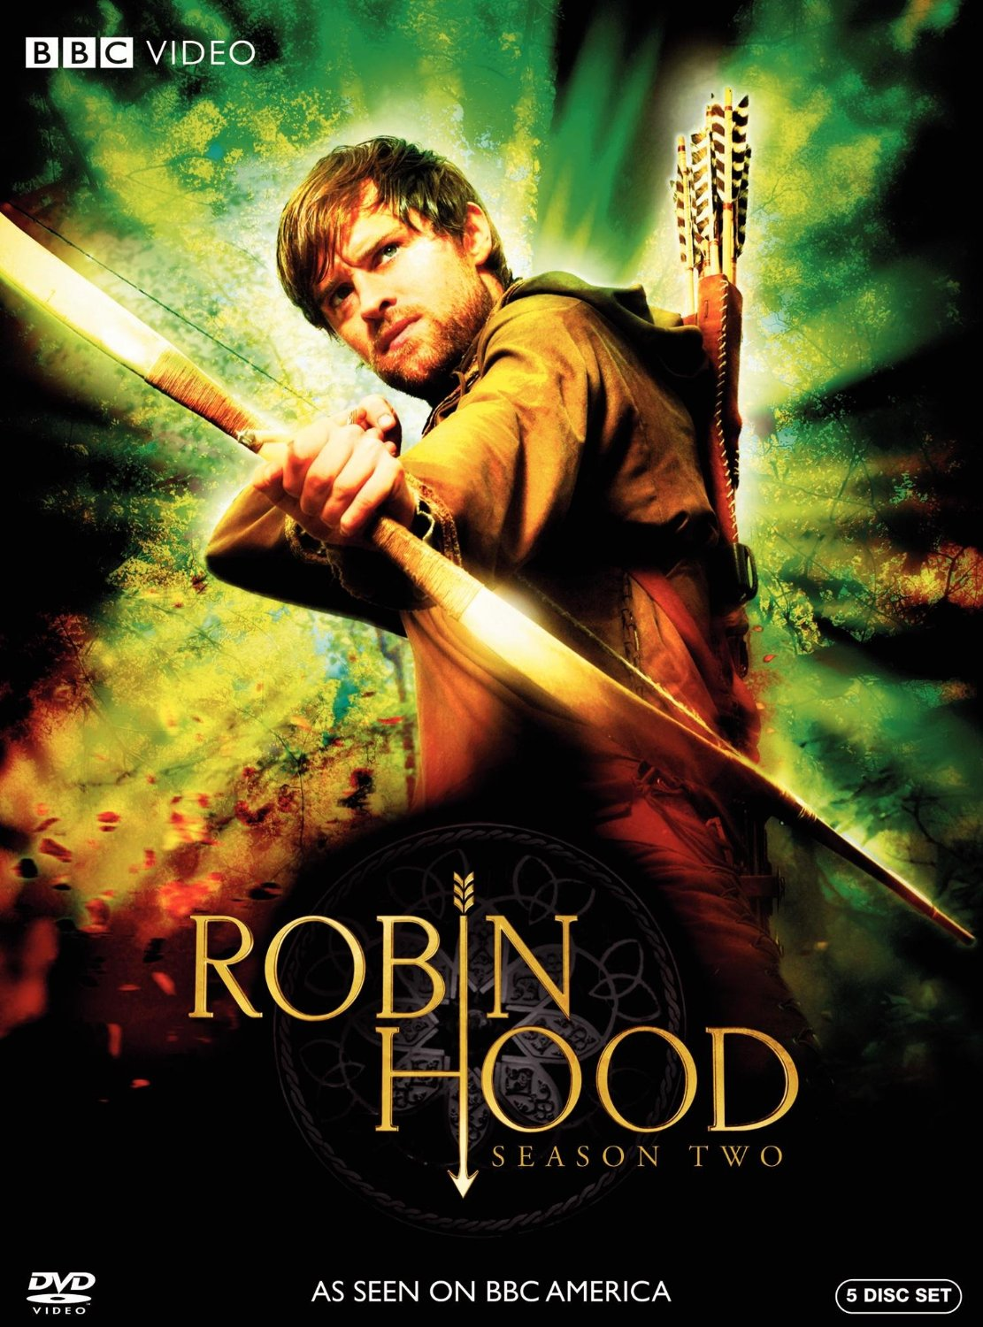
What is the London home of the Queen?

Slide 11
2. What is the London home of the Queen?

Slide 12
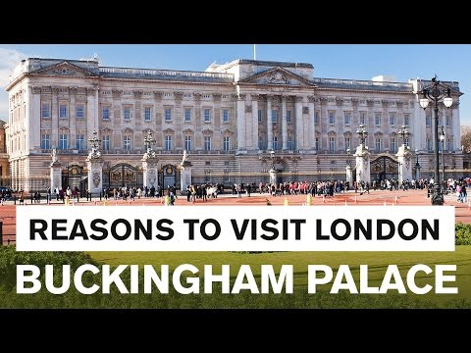

Slide 13
3. Who was the first woman Prime Minister of Great Britain?

Slide 14
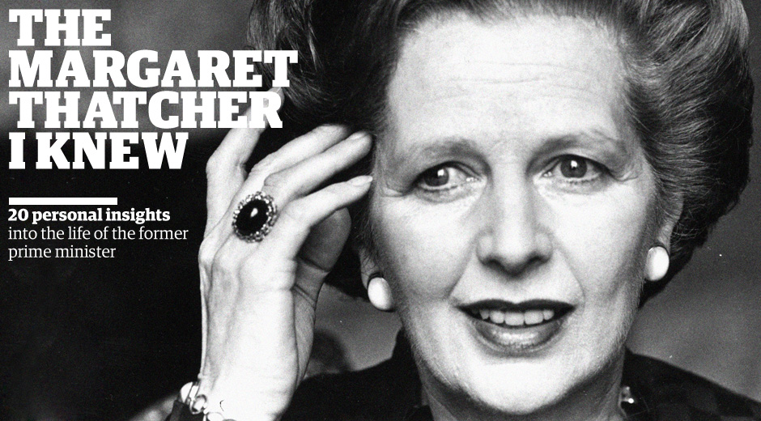

Slide 15
4. How is the London underground often called?

Slide 16


Slide 17
5. Who lives at 10 Downing Street in London?

Slide 18
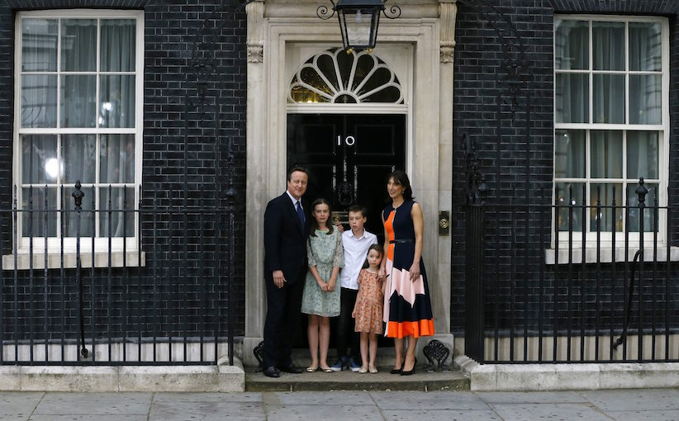
British Prime Minister

Slide 19
6. The museum at Baker Street in London is devoted to this person.

Slide 20
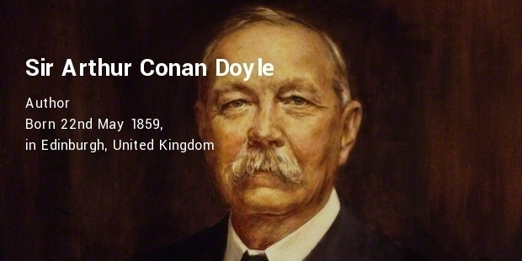

Slide 21
7. What English writer was born on Stradford-upon-Avon?

Slide 22
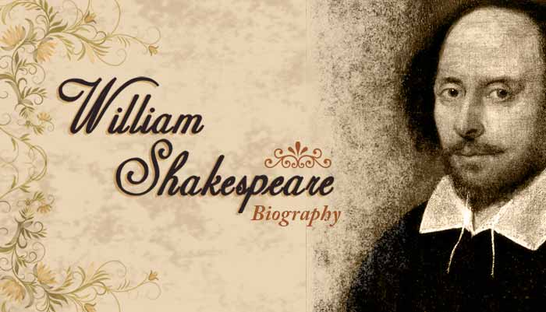

Slide 23
8. The mysterious Loch Ness Monster is from …

Slide 24
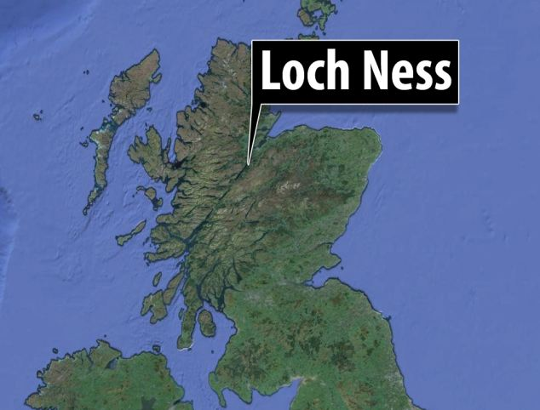
Scotland

Slide 25

1. What city stands on the river Thames?

Slide 26
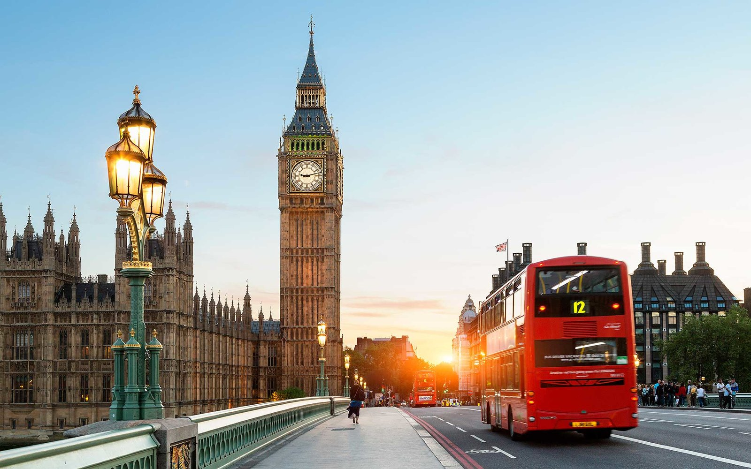

Slide 27
2. The legend says that without them the Tower will fall.

Slide 28
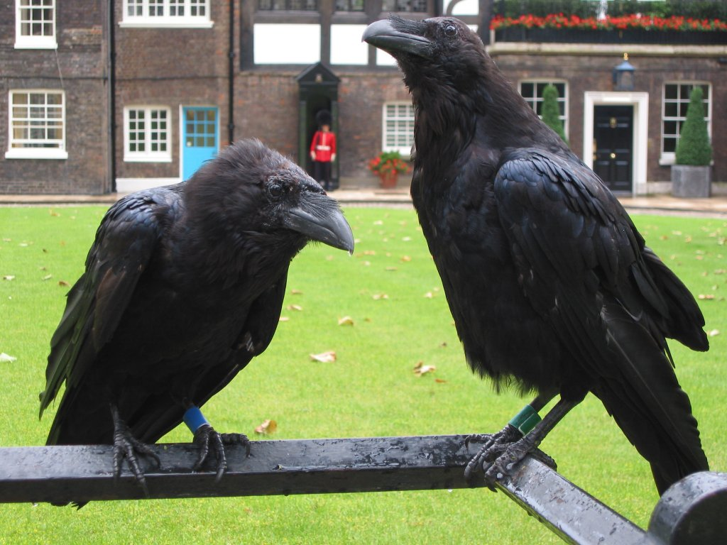
Ravens

Slide 29
3. The Princess Diana was the wife of …?

Slide 30
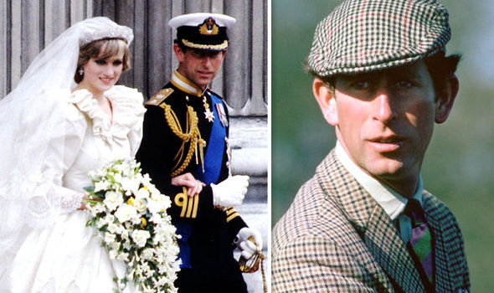
Prince Charles

Slide 31
4. In what city did the Beatles start their career?

Slide 32
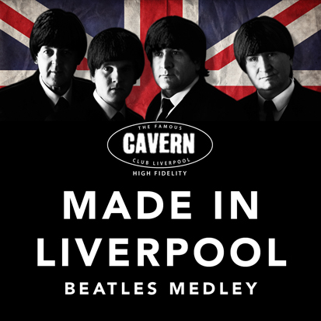

Slide 33
5. What can you see at Madam Tussaud’s Museum?

Slide 34
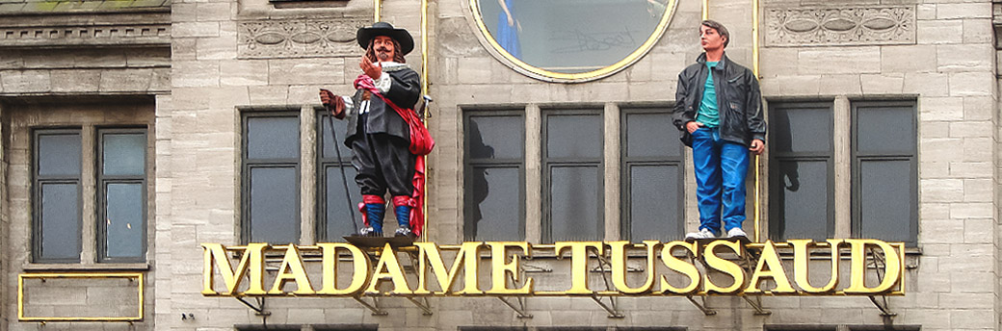
Wax figures of famous people

Slide 35
6. What animal is pictured on the national flag of Wales?

Slide 36
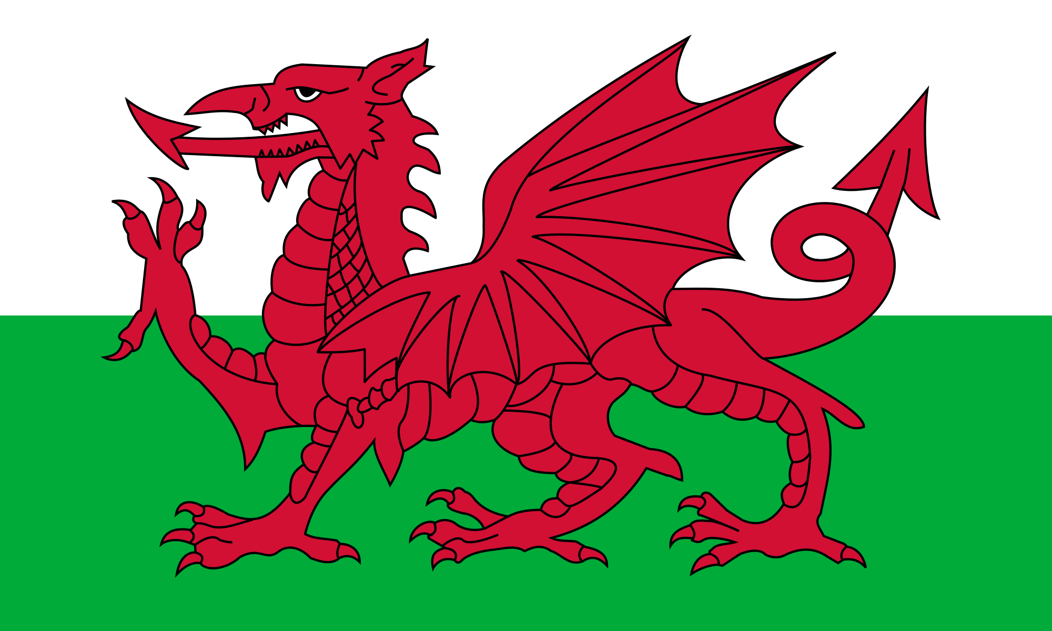
A dragon

Slide 37
7. In this country the national clothes are the skirts. What country is it?

Slide 38
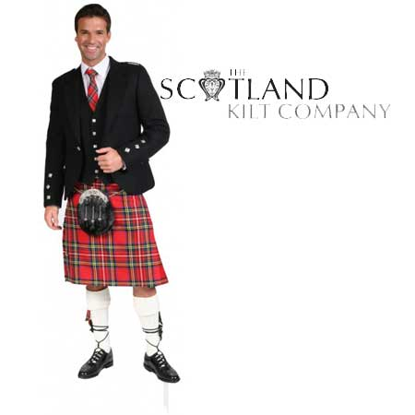

Slide 39
8. Where are the British kings and queens crowned?

Slide 40
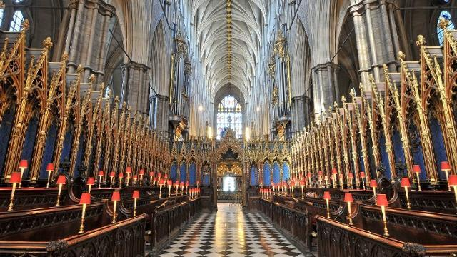
Westminster Abbey

Slide 41
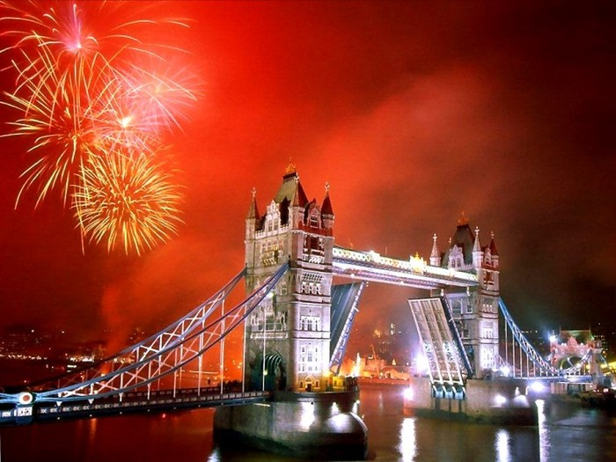
Round 4
Name the famous places of interest

Slide 42
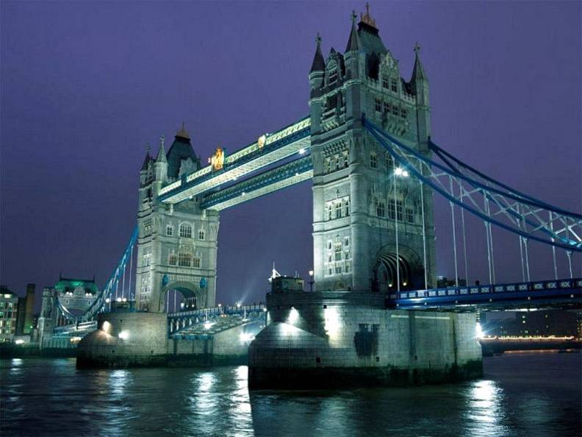

Slide 43
Tower Bridge

Slide 44
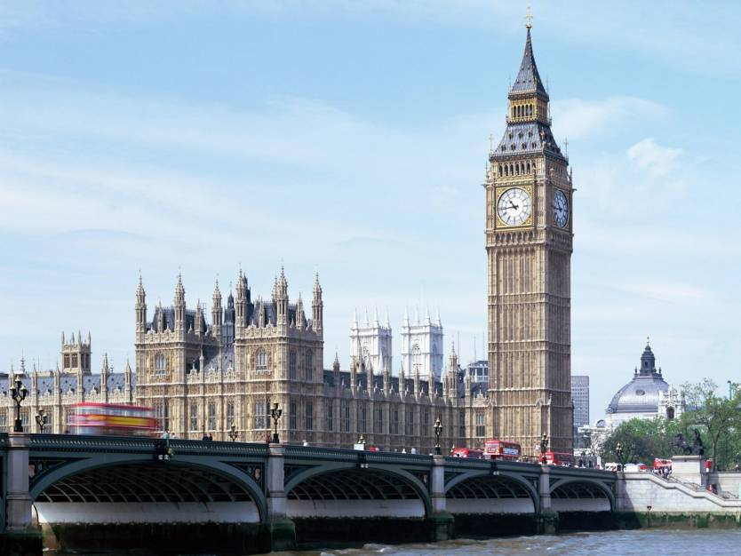

Slide 45
Big Ben and the Houses of
Parliament

Slide 46
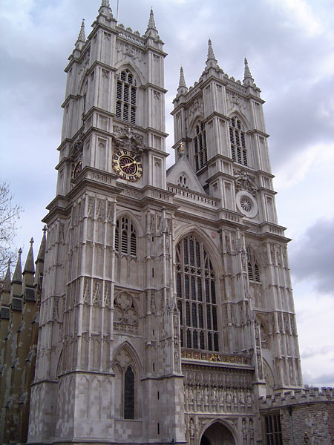

Slide 47
Westminster Abbey

Slide 48
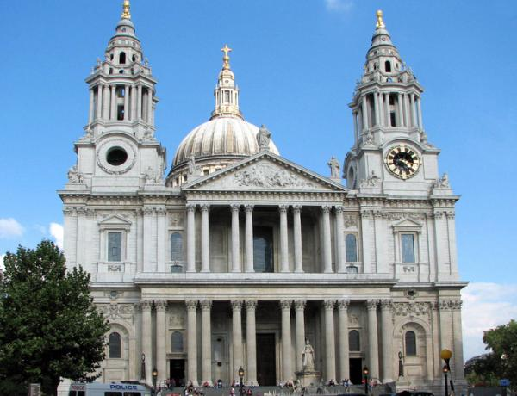

Slide 49
St.Paul’s Cathedral

Slide 50
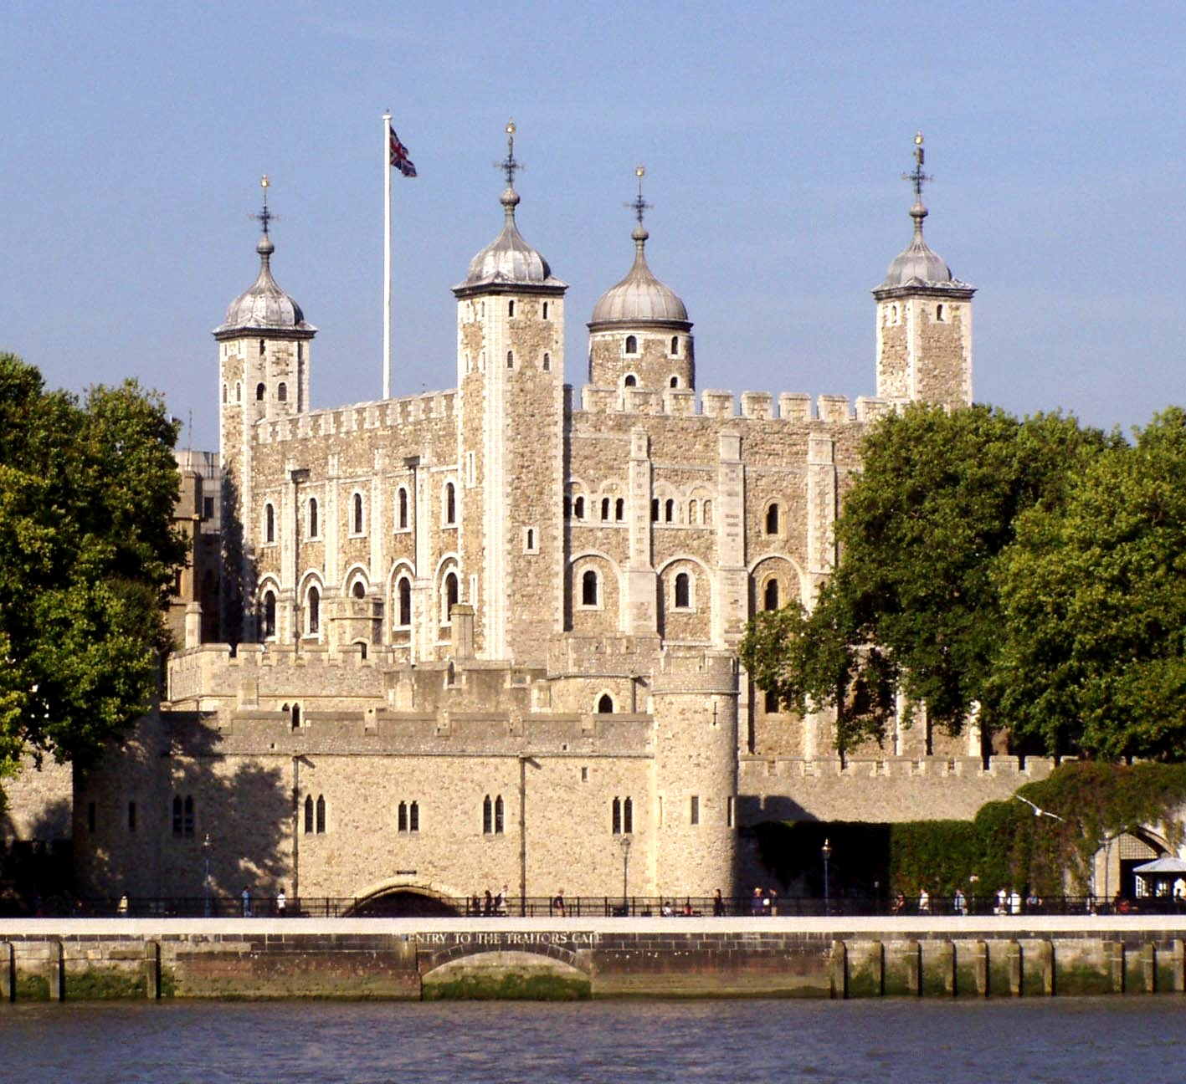
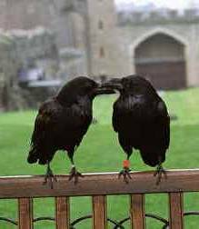

Slide 51
The Tower of London

Slide 52
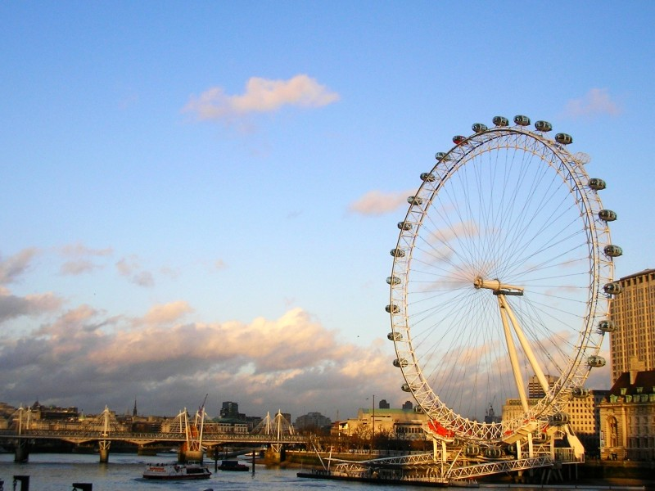

Slide 53
London Eye

Slide 54
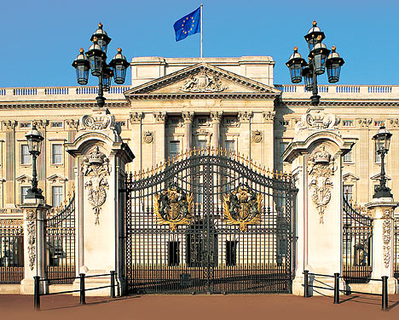

Slide 55
Buckinghem Palace

Slide 56
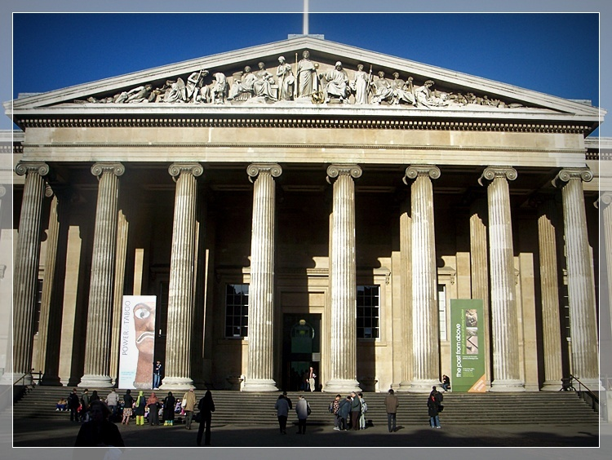

Slide 57
The British Museum

Slide 58
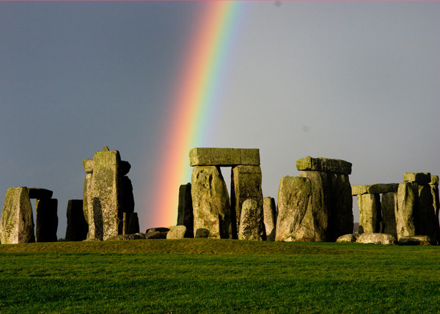

Slide 59
Stonehenge

Slide 60
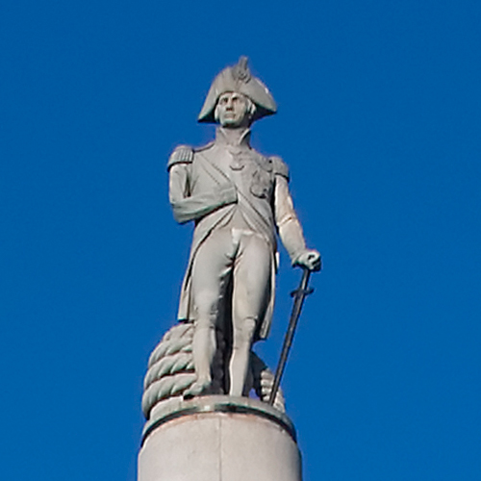

Slide 61
Admiral Nelson’s monument

Slide 62
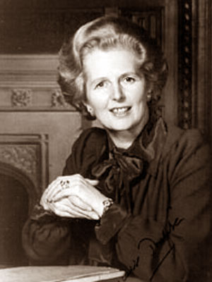
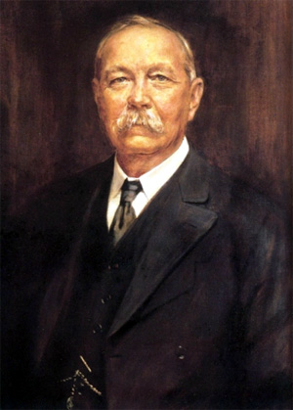
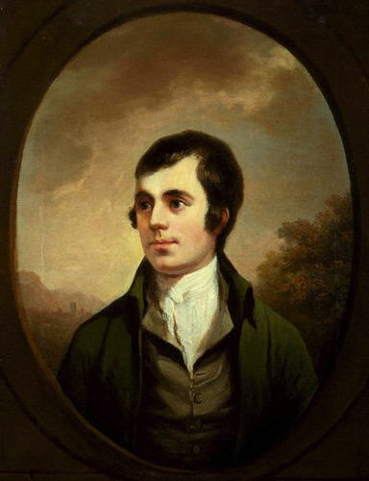
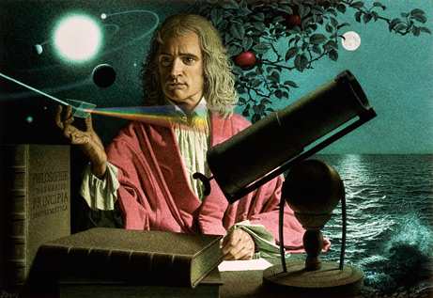
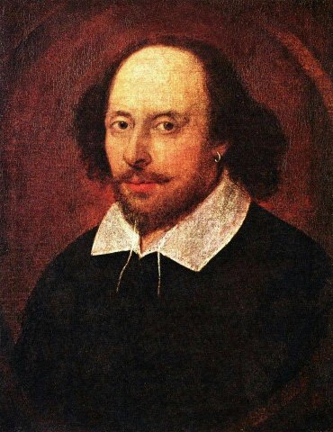
Round 5
Famous British People

Slide 63
Match the names of the famous people with their achievements and descriptions
1. Isaac Newton | a. a famous painter
2. Alexander Bell | b. wrote “Robinson Crusoe”
3. William Turner | c. created Sherlock Holmes
4. Jonathan Swift | d. “The iron lady”
5. Alexander Fleming | e. opened penicillin
6. Conan Doyle | f. Wrote “Alice in Wonderland”
7. Lewis Carol | g. invented a telephone
8. Margaret Thatcher | h. a well-known Scottish poet
9. Rudyard Kipling | i. the legendary group “Beatles”
10. Robert Burns | j. the author of “The Jungle Book (Mowgli)”
11. William Shakespeare | k. wrote “The Adventures of Gulliver”
12. Daniel Defoe | l. The most famous English writer, the author of “Romeo and Juliet”
13. John Lennon, George Harrison, Paul McCartney, Ringo Starr | m. opened the law of universal gravitation

Slide 64
Match the names of the famous people with their achievements and descriptions
1. Isaac Newton | m. opened the law of universal gravitation
2. Alexander Bell | g. invented a telephone
3. William Turner | a. a famous painter
4. Jonathan Swift | k. wrote “The Adventures of Gulliver”
5. Alexander Fleming | e. opened penicillin
6. Conan Doyle | c. created Sherlock Holmes
7. Lewis Carol | f. Wrote “Alice in Wonderland”
8. Margaret Thatcher | d. “The iron lady”
9. Rudyard Kipling | j. the author of “The Jungle Book (Mowgli)”
10. Robert Burns | h. a well-known Scottish poet
11. William Shakespeare | l. The most famous English writer, the author of “Romeo and Juliet”
12. Daniel Defoe | b. wrote “Robinson Crusoe”
13. John Lennon, George Harrison, Paul McCartney, Ringo Starr | i. the legendary group “Beatles”

Slide 65

Round 6
PROVERBS

Slide 66

Better late than never East or West - home is best My home is my castle Live and learn All's well that ends well Don’t carry your coals to Newcastle Rome was not built in a day A friend in need is a friend indeed Business before pleasure A cat in gloves catches no mice There is no smoke without fire Every thing is good in its season

Slide 67
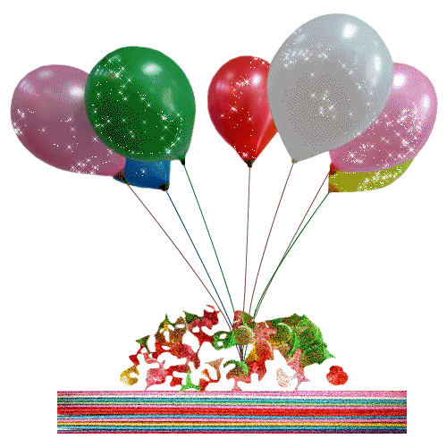
ROUND 7
HOLIDAYS

Slide 68
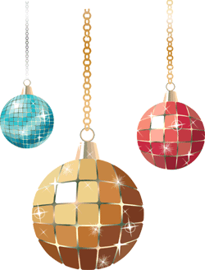
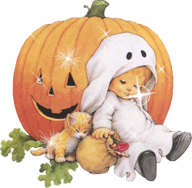
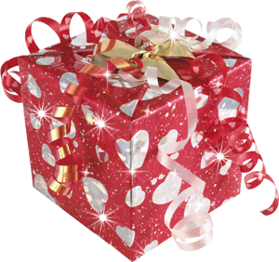
True or false?
In Britain Christmas is celebrated on the 25-st of December.
On the 31-st of October the British celebrate Easter.
“Jack-o’-Lantern” is made from melon.
The British play jokes and tricks on the 1-st of May.
Mother’s Day is celebrated in May.
Eggs and chocolate rabbits are the symbol of Easter.

Slide 69
True or false?
In Britain Christmas is celebrated on the 25-st of December. True
On the 31-st of October the British celebrate Easter. False
“Jack-o’-Lantern” is made from melon. False
The British play jokes and tricks on the 1-st of May. False
Mother’s Day is celebrated in May. True
Eggs and chocolate rabbits are the symbols of Easter. True

Slide 70
ROUND 8
Solve the crossword,
find the key word

Slide 71
Solve the crossword and find the key to complete the sentence-
The British royal coat-of-arms shows a lion and a …
 |  |  | 4
 | 2 |  |  | 5 | 6 | 7
 |  | 3
1
What is the traditional Christmas dish in Britain?
“Winnie-the-Pooh” was written by Alan …
What is the name of the British Queen?
The name of the famous British politician was Winston …
What is the oldest university in Britain?
St. Valentine’s Day is observed in … (month)
What was the political nickname of Margaret Thatcher? … Lady?

Slide 72
Solve the crossword and find the key to complete the sentence-
The British royal coat-of-arms shows a lion and a …
 |  |  | 4 c
 | 2 m |  | h | 5 o | 6 f | 7 i
 | i | 3 e | u | x | e | r
1 t | l | l | r | f | b | o
u | n | i | c | o | r | n
r | e | z | h | r | u
k |  | a | i | d | a
e |  | b | l |  | r
y |  | e | l |  | y
 |  | t
 |  | h
What is the traditional Christmas dish in Britain?
“Winnie-the-Pooh” was written by Alan …
What is the name of the British Queen?
The name of the famous British politician was Winston …
What is the oldest university in Britain?
St. Valentine’s Day is observed in … (month)
What was the political nickname of Margaret Thatcher? … Lady?

Slide 73
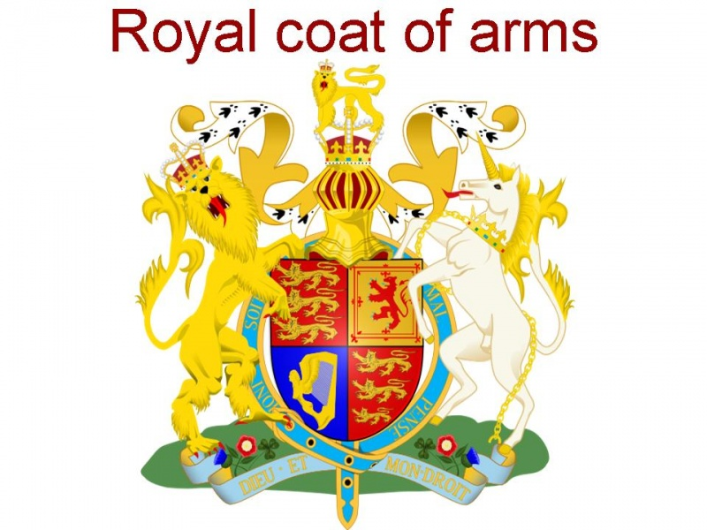
A lion and a unicorn

Slide 74


